Slide 1
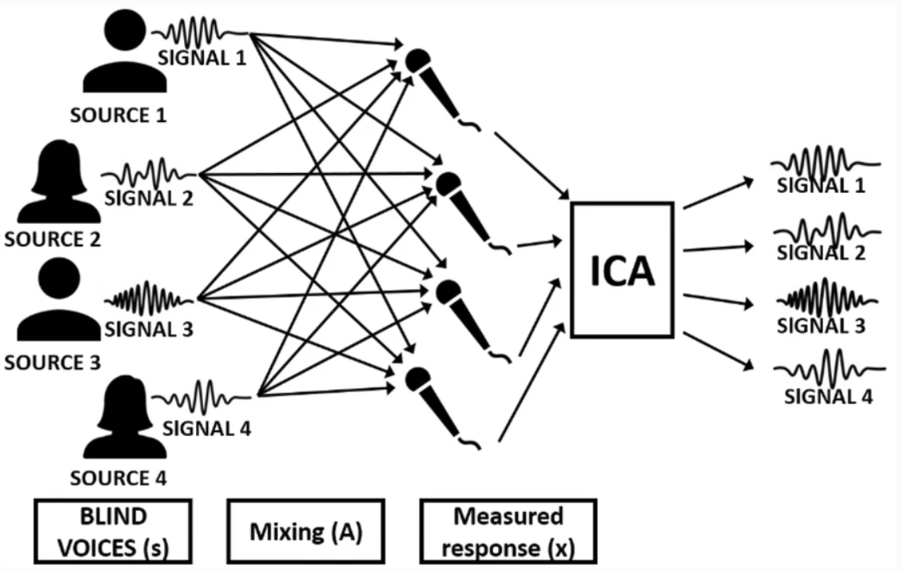
cocktail party problem
X=A*S
A*S=X

Slide 2
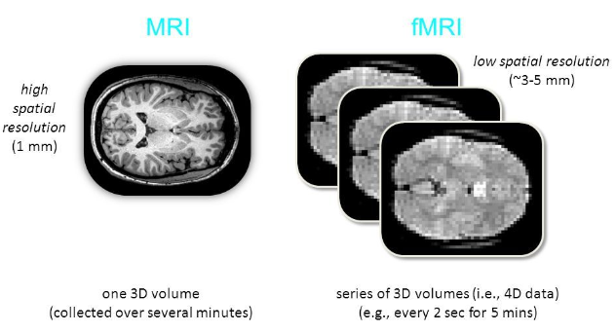
voxel

Slide 3
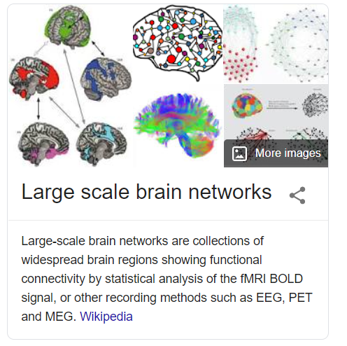
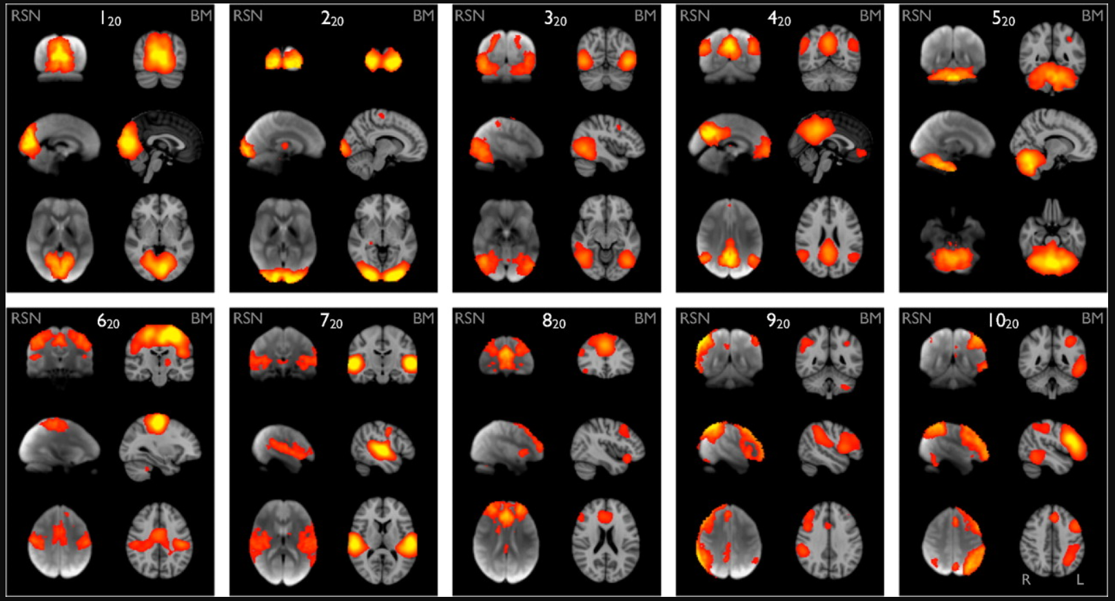
A live brain is never in rest, even during “resting-state”.
SM. Smith, et al., PNAS, 2009.
Ten well-matched pairs of networks from the meta- analysis of the 29,671-subject BrainMap activation database and (a completely separate analysis of) the 36-subject resting-state fMRI dataset.

Slide 4
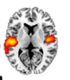
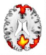
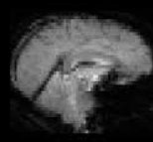


Input:
outputs:
data matrix
3D image in flattened,
all voxels of each time point
mixing matrix
source matrix
space
source
space
time
X
source
=
time
network n
network m
time course n
time course m

Slide 5
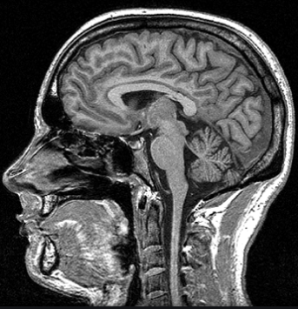
Input:
outputs:
data matrix
3D image in flattened,
all voxels of each subject
mixing matrix
source matrix
space
source
space
X
source
subject
=
subject
network n
network m
loadings n
loadings m

Slide 6
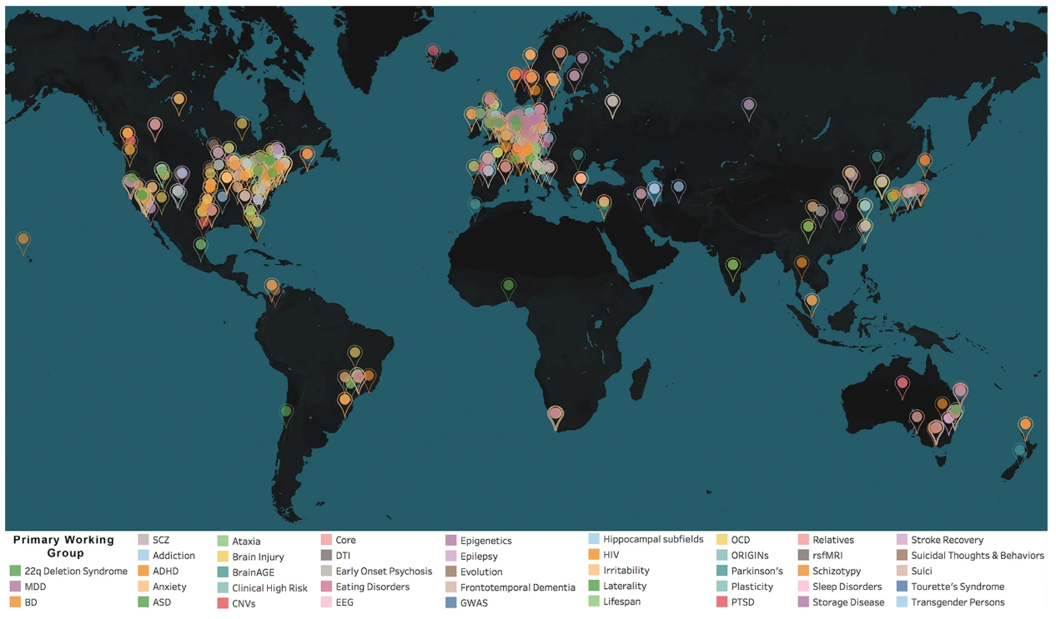

Neuroimaging research is a collaborative effort, collaborative networks of researchers working together on a range of large-scale studies have been initiated.
A prominent issue with a multicentre study is the heterogeneity of the data from scanners with different manufacturers (Siemens, GE, Philips…) and field strength (1.5T, 3T…).

Slide 7
Analysis strategy 1 of source-based morphometry for multi-centre studies
voxels
PCA
voxels
components
subjects
site 1
voxels
PCA
concatenate
subjects
subjects
site 2
X’group
before PCA
Xgroup
=
Agroup
components
Sgroup
…
…
PCA
site n
PCA
back-reconstruction
A1
S1
…
An
Sn
Analysis strategy 2 of source-based morphometry for multi-centre studies
voxels
voxels
components
voxels
subjects
site 1
X’group
before PCA
subjects
subjects
Xgroup
=
Agroup
components
Sgroup
…
concatenate
PCA
site n

Slide 8
We want to demonstrate our analysis strategy (strategy 1) outperforms the conventional one (strategy 2).

Slide 9
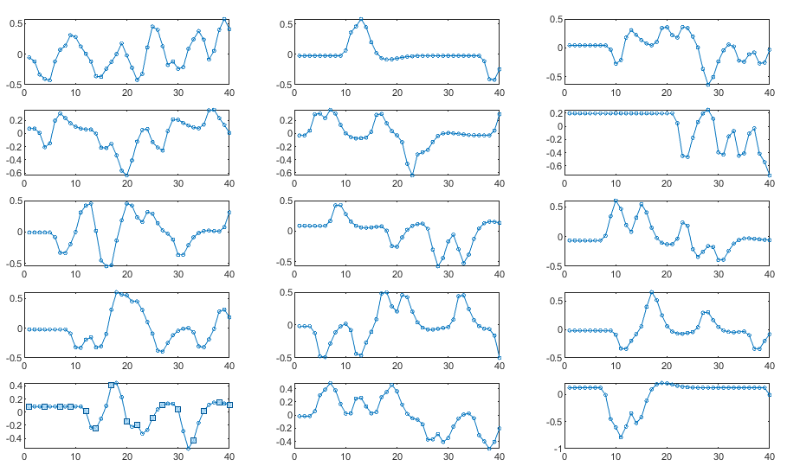
Simulation: gray matter volume data from 3 different research sites, these datasets have different CNR (contrast-to-noise ratio) levels, reflecting the different noise levels of different scanners in a multi-centre study.
site 1: 40 subjects, 15 components, CNR = 1;
site 2: 35 subjects, 15 components, CNR = 5;
site 3: 35 subjects, 15 components, CNR = 10.
spatial maps of the structural brain networks
In this pilot study, we will compare four conditions:
analysis strategy 1 with non-harmonized data;
analysis strategy 1 with harmonized data with ComBat*;
analysis strategy 2 with non-harmonized data;
analysis strategy 2 with harmonized data with ComBat.
loading vectors of structural brain networks of the site 1 dataset
* JP. Fortin et al., 2018.

Slide 10
analysis strategy 1, with non-harmonized data
group-level results
simulated site 1 (CNR=1)
simulated site 2 (CNR=5)
simulated site 3 (CNR=10)

Slide 11
analysis strategy 1, with harmonized data
group-level results
simulated site 1 (CNR=1)
simulated site 2 (CNR=5)
simulated site (CNR=10)

Slide 12
analysis strategy 2, with non-harmonized data
analysis strategy 2, with harmonized data

Slide 13
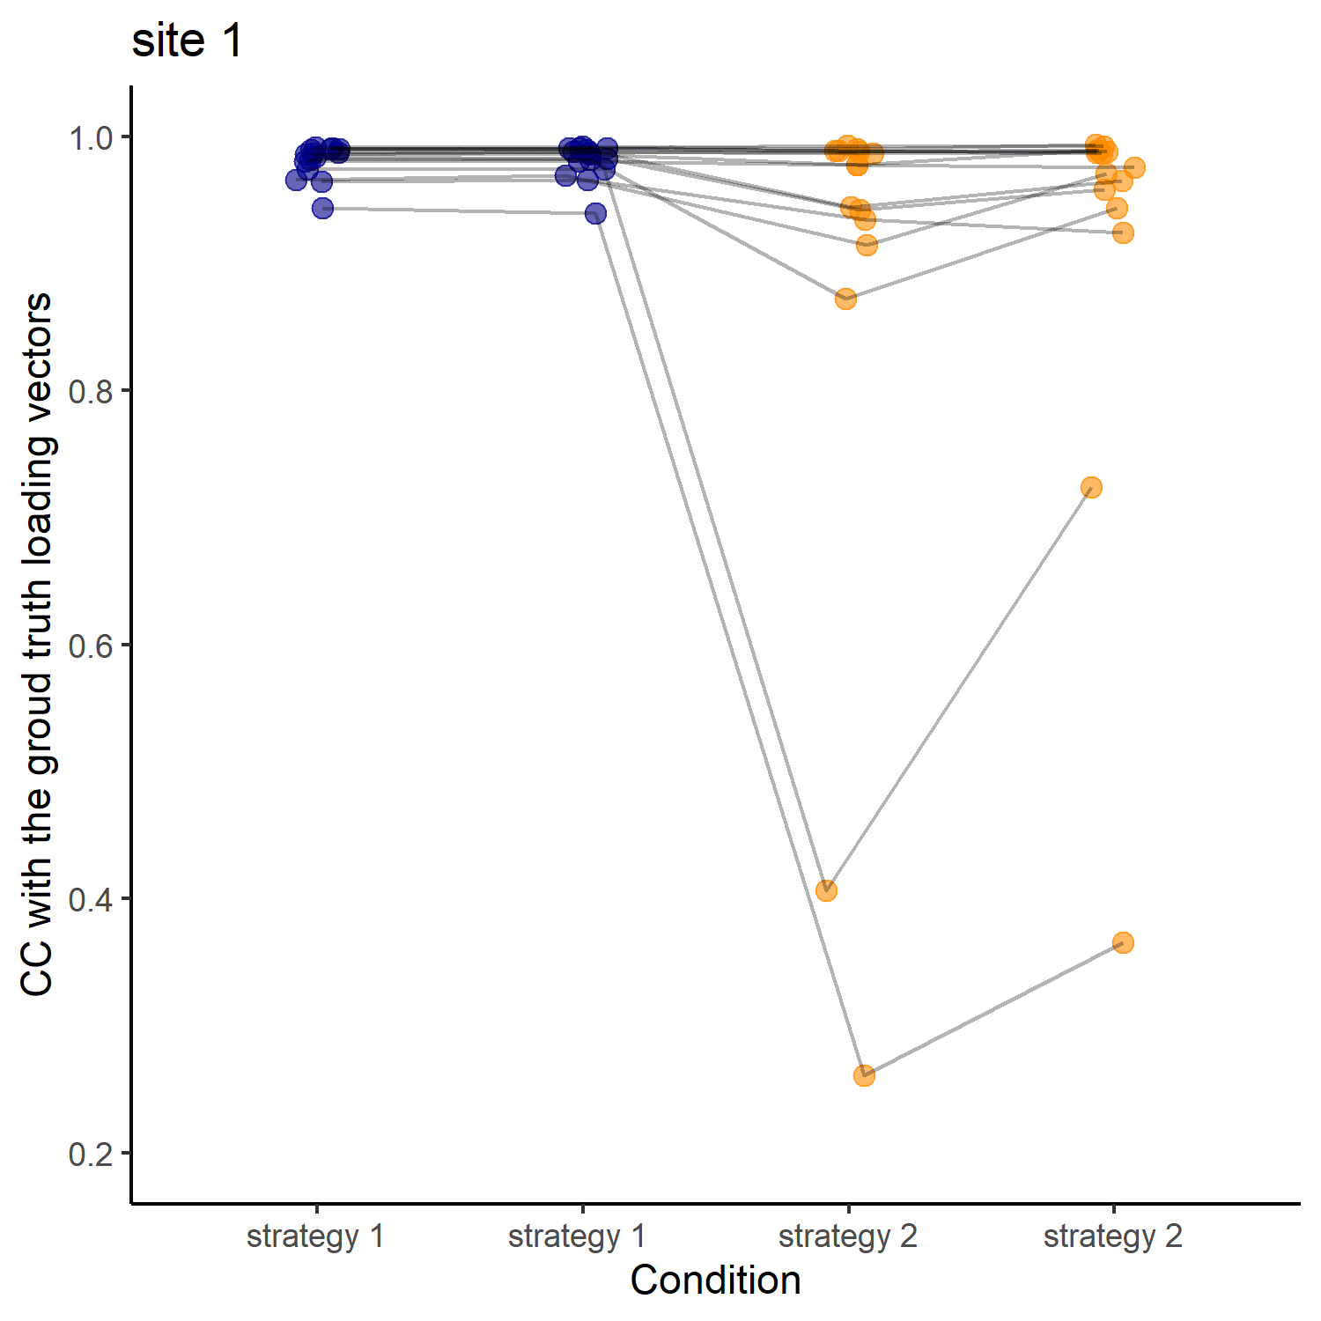
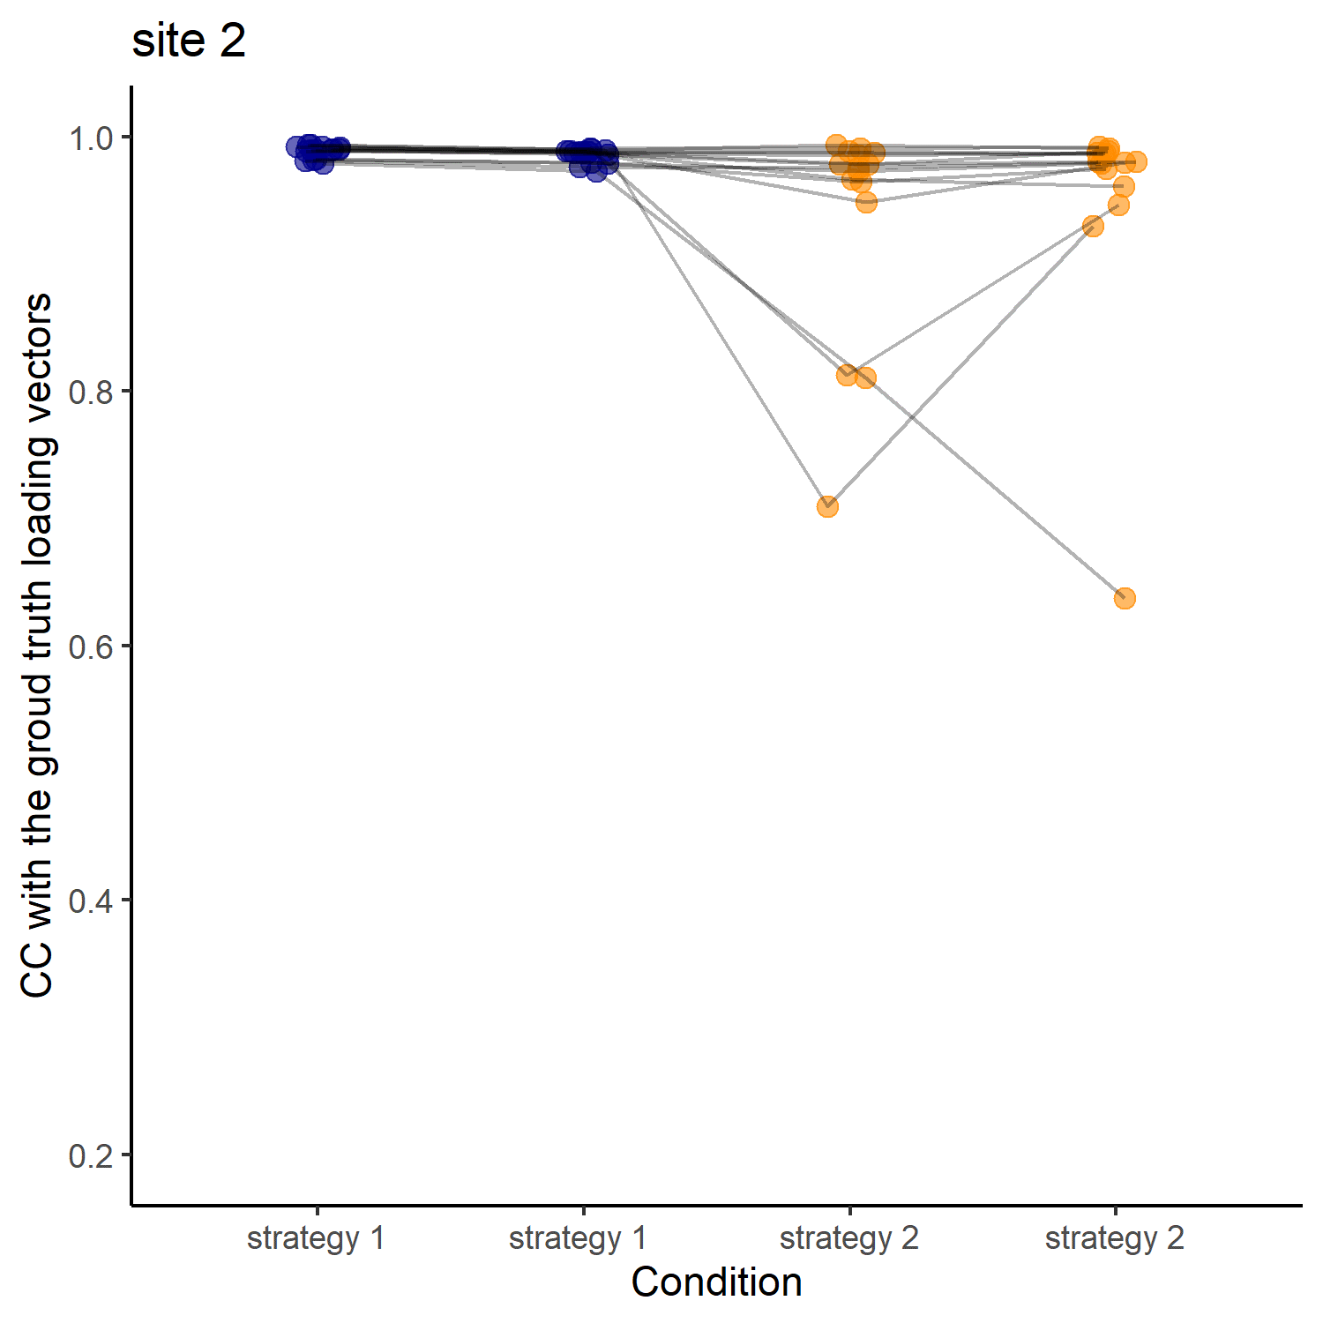

correlation coefficient (CC) between the estimated loading vectors and ground truth
non-harmonized
harmonized
non-harmonized
harmonized
non-harmonized
harmonized
non-harmonized
harmonized
non-harmonized
harmonized
non-harmonized
harmonized

Slide 14
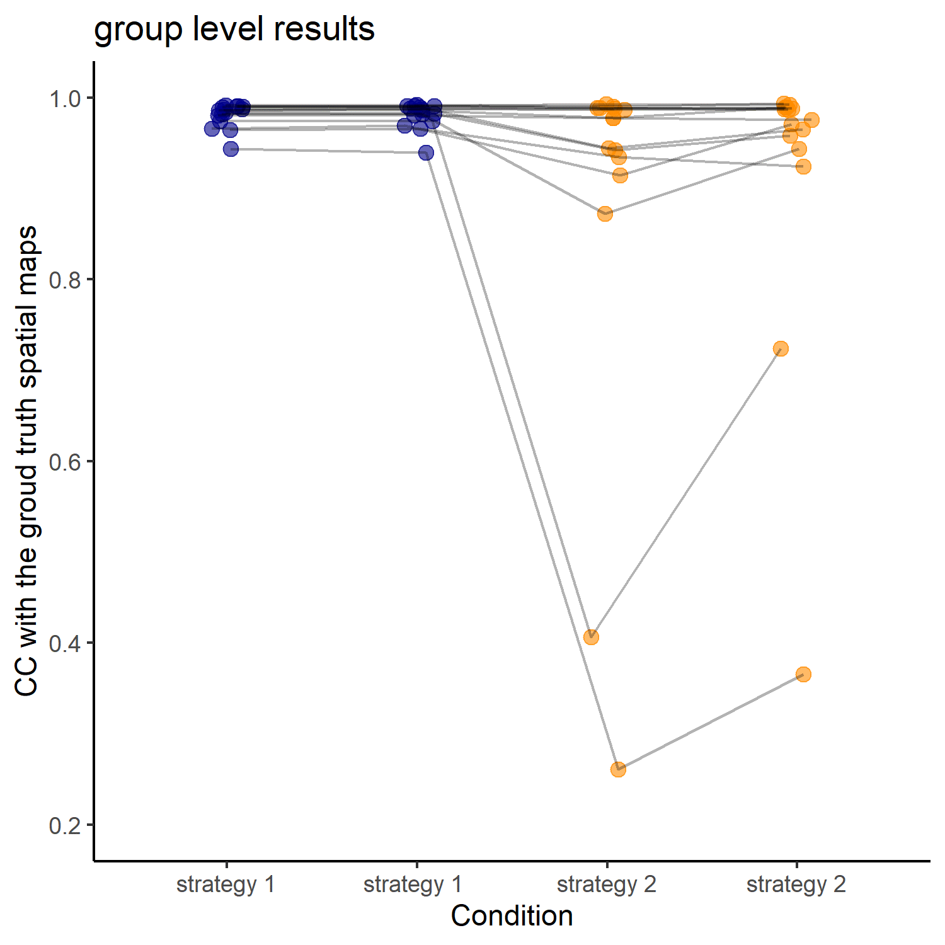
correlation coefficient (CC) between the estimated spatial maps and ground truth
non-harmonized
harmonized
non-harmonized
harmonized

Slide 15
Next steps:
Survey on SNR (signal-to-noise ratio) or CNR ranges of T1-weighted MRI data from different scanners and different field strength
Simulation with SimTB Matlab toolbox
simulation data generation
ComBat hormanization
ICA analysis
statistical analyses
Simulation with realistic MRI data (1.5T and 3T from the lab)

